Slide 1
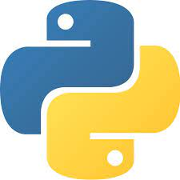
19I210 Python Programming Laboratory
Dr.B.Sangeetha Assistant Professor (Sr.Gr)

Slide 2
Objectives
To inculcate analytical and programming skills
To introduce syntax and semantics of Python
Outcomes
To create programs and application in Python
To demonstrate mastery in application development

Slide 3
Syllabus
Basic Programs
Control Statements and Looping
Functions and Lambda Functions
String Handling
Lists, Tuples, Set and Dictionary
Files and I/O Handling
Packages & Modules
Exception Handling
Class and Inheritance
Database Connectivity

Slide 4
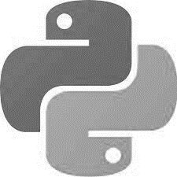
Python
High-level programming language.
Emphasizes code readability with the use of significant indentation.
Creator - Guido van Rossum
1991 Python 0.2.0
2000 Python 2.0
2008 Python 3.0 (not backward compatible)
Install Python : https://www.python.org/downloads/ (Compatible to the OS and System Architecture)

Slide 5

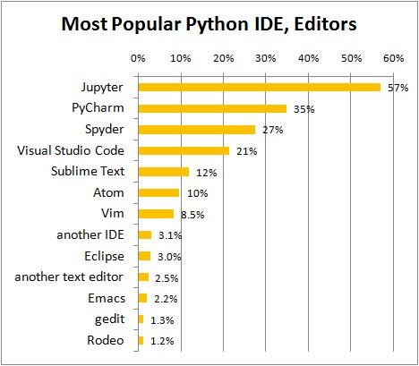
Python Editors
IDLE
(Integrated Development Learning
Environment)
Jupyter
Spyder
Google Colab (colab.research.google.com)
Free web service, offers run-time environment through Jupyter Notebooks

Slide 6
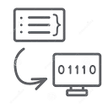
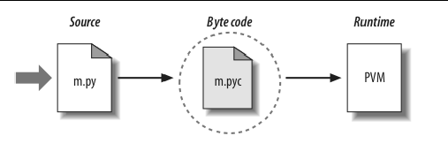
Compiler vs Interpreter
Translates source code → machine code
Compiler – Entire file at a time
Interpreter – One instruction at a time
Python No explicit compilation

Slide 7
Why Python?
Easy to write programs
Wide range of applications
Machine Learning, Web Development, Gaming
Wider community support

Slide 8






Use cases
Netflix
Uber
Pinterest
Quora
Instagram

Slide 9



Object Oriented Programming
Concept of class and objects /
Concept of functions and logics
Student Name
Aggregate Marks
Aggregate Marks
Roll Number
Find Grade
Find Grade
Mark 1
Find Backlogs
Mark 2

Slide 10
Object Oriented Programming Principles
Encapsulation
Wrap data and code
Expose only what is required
Data Hiding
Hide complex details
Inheritance
Reusability of the common data and methods
Polymorphism
Objects exhibit different behavior based on the current
context

Slide 11

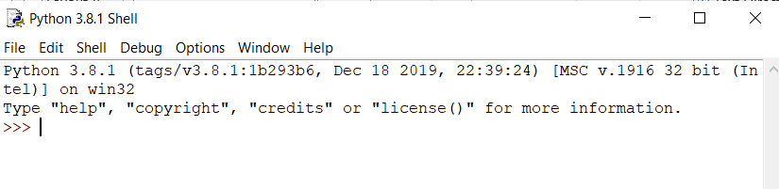
Basics of Python
Source file created with .py extension
Instructions
Expressions (Operators , values)
>>> (prompt)

Slide 12

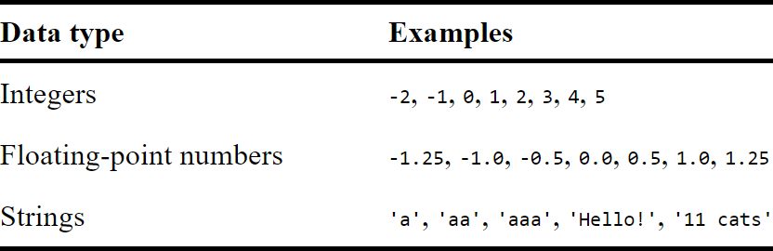
Basics of Python
Data

Slide 13
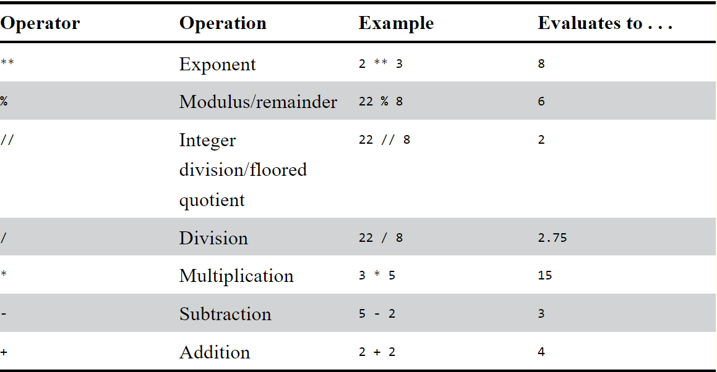
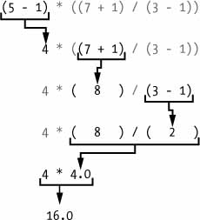
Operators
Precedence & Associativity

Slide 14

Variables
Storing values
Associate name with a quantity
>>> a = 42
Can store any type of value
>>> a = ‘hello’
42
a
42
hello
a

Slide 15

print() and input() functions
Display values
Accepts one argument
Expression (or) value to be displayed
>>> print(‘hello’)
Accept input , receive and store it as string
>>> a = input()
Waits for user input , Convert it into string

Slide 16

str(), int(), float() functions
str() | convert int (or) float to a string
int() | convert numeric string (whole number) (or) float to integer
float() | convert numeric string (decimal number) (or) integer to float

Slide 17

References
https://automatetheboringstuff.com/

